Slide 1
Basic Concepts of Java, Applet and Byte Code
Name : Rupak Sarkar Roll No.: 14271024036 Stream : MCA Semester : Semester 2nd Subject : Object Oriented Programming with Java Subject Code : MCAN-203

Slide 2
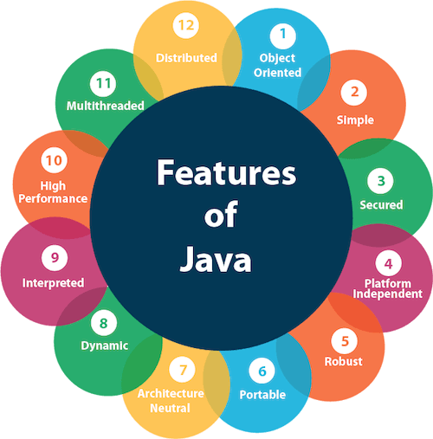
Features of Java
Object Oriented – Java is an object-oriented programming language.
Simple – Java is very easy to learn, and its syntax is simple, clean and easy to understand.
Secured – With Java, we can develop virus-free systems.
Platform Independent – Java is platform independent.
Robust – Java is a robust programming language.
Portable – Java is portable because it facilitates you to carry the Java bytecode to any platform
Architecture Neutral – Java is architecture neutral because there are no implementation dependent features

Slide 3
How has Java changed the Internet?
Java significantly impacted the internet by enabling the development of dynamic and interactive web applications through features like applets, allowing developers to create cross-platform applications that could run on any operating system, thus making the web more accessible and paving the way for complex web functionalities
Applets:
Java introduced the concept of applets, small programs that could be embedded directly into web pages, allowing for interactive elements like animations and mini-applications within the browser.
Platform independence:
Java's "Write Once, Run Anywhere" philosophy meant that applications developed in Java could run on any operating system with a Java Runtime Environment (JRE) installed, making it highly portable.
Security:
Java's built-in security features helped to protect users from malicious code when running applets on the web.

Slide 4
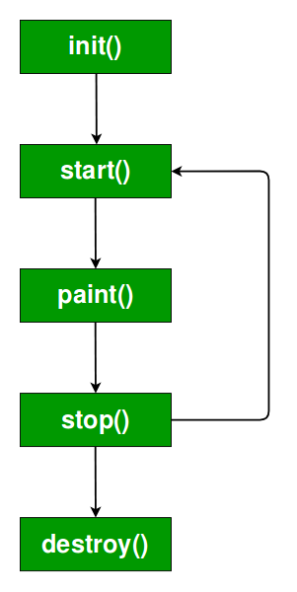
What is Applet?
Java Applets was once a very popular feature of web applications. Java Applets were small programs written in Java that ran inside a web browser.
Key Points:
Applet Basics: Every applet is a child/subclass of the java.applet.Applet class.
Not Standalone: Applets don’t run on their own like regular Java programs. They need a web browser or a special tool called the applet viewer (which comes with Java).
No main() Method: Applets don’t start with main() method.
Display Output: Applets don’t use System.out.prinln() for displaying the output, instead they use graphics methods like drawString()

Slide 5
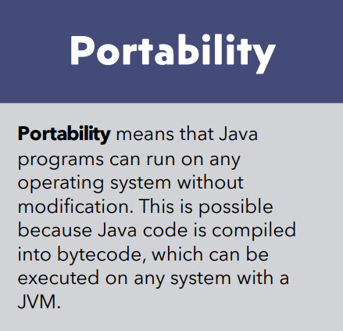
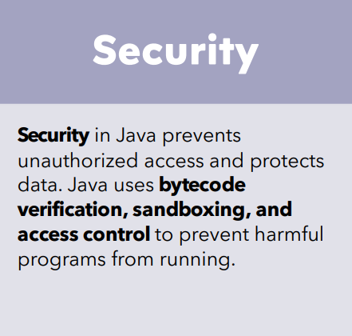

Slide 6
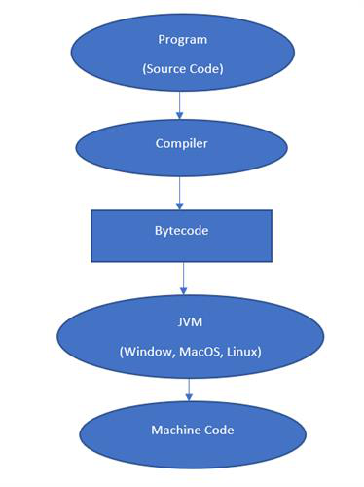
What is Byte Code?
Bytecode in Java is an intermediate, platform-independent representation of a Java program. When a Java program is compiled, it is not converted directly into machine code (which is specific to a particular processor and operating system). Instead, it is converted into bytecode (.class files), which can be executed on any system with a Java Virtual Machine (JVM).

Slide 7
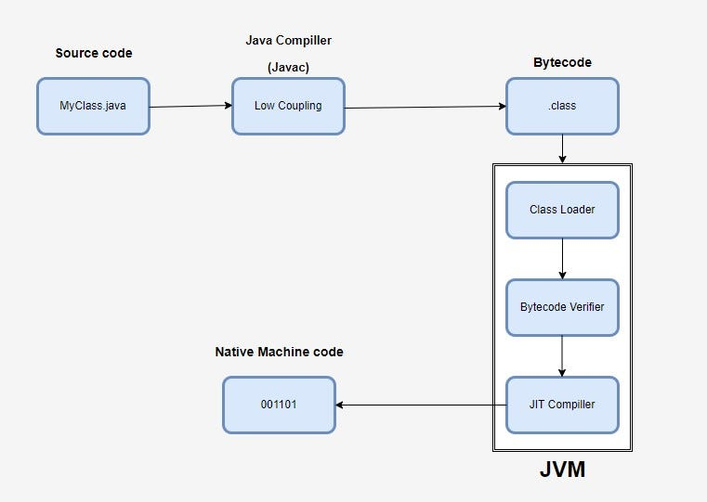
How java ensures both portability and security by introducing bytecode and JVM?
The compilation process in Java ensures that source code is transformed into an optimized, secure, and platform-independent format (bytecode), ready to be executed by the JVM. This multi-step process includes writing the source code, invoking the compiler, generating bytecode, and verifying the bytecode, culminating in execution on the JVM.

Slide 8
Thank You!

